Slide 1

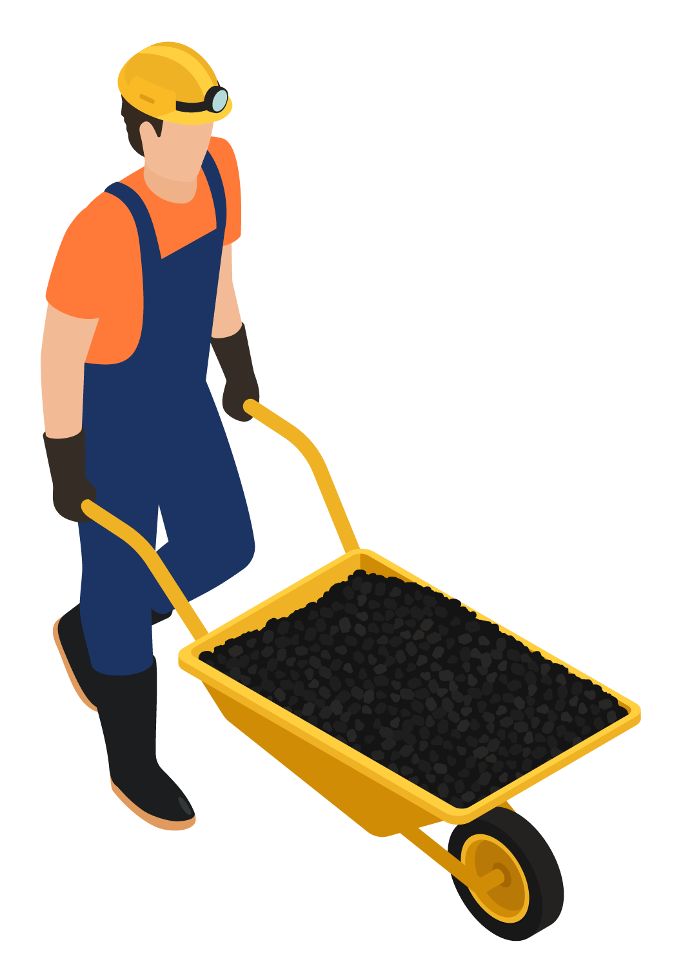


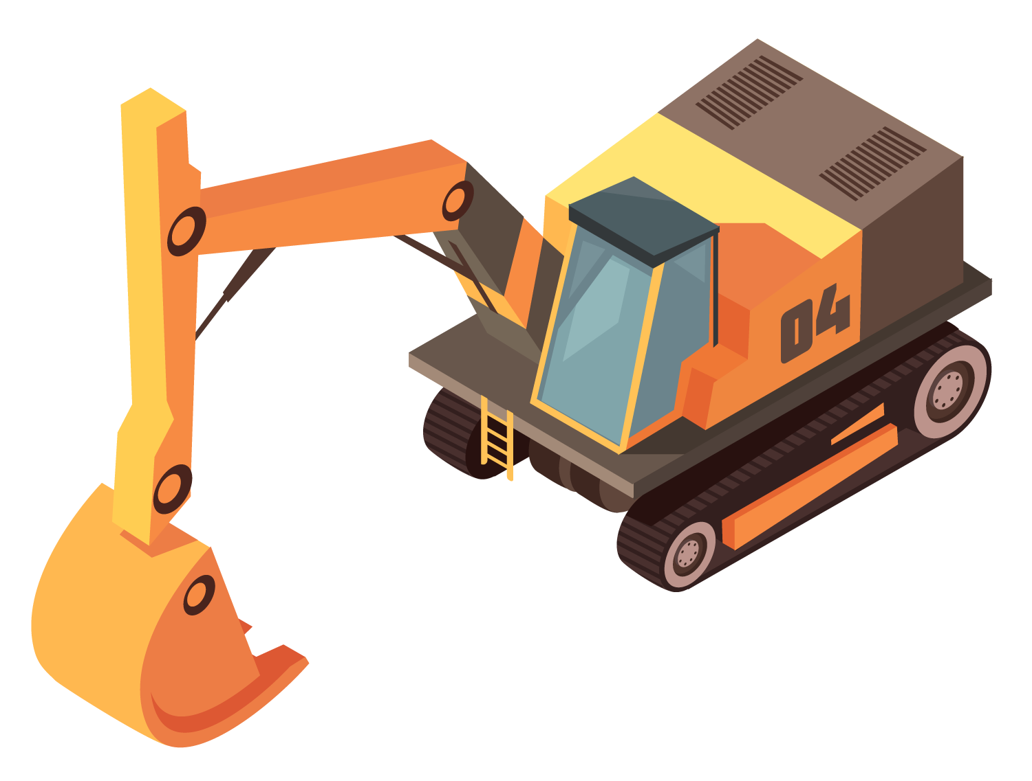



Mine workers' Health and Environment monitoring and flood prediction system
Project Guide- Mrs. Archana Khodake
Ajay Shitkar (20EE5009)
Tanmay Thakur (20EE5007)
Sakshi Sonone (20EE5011)

Slide 2
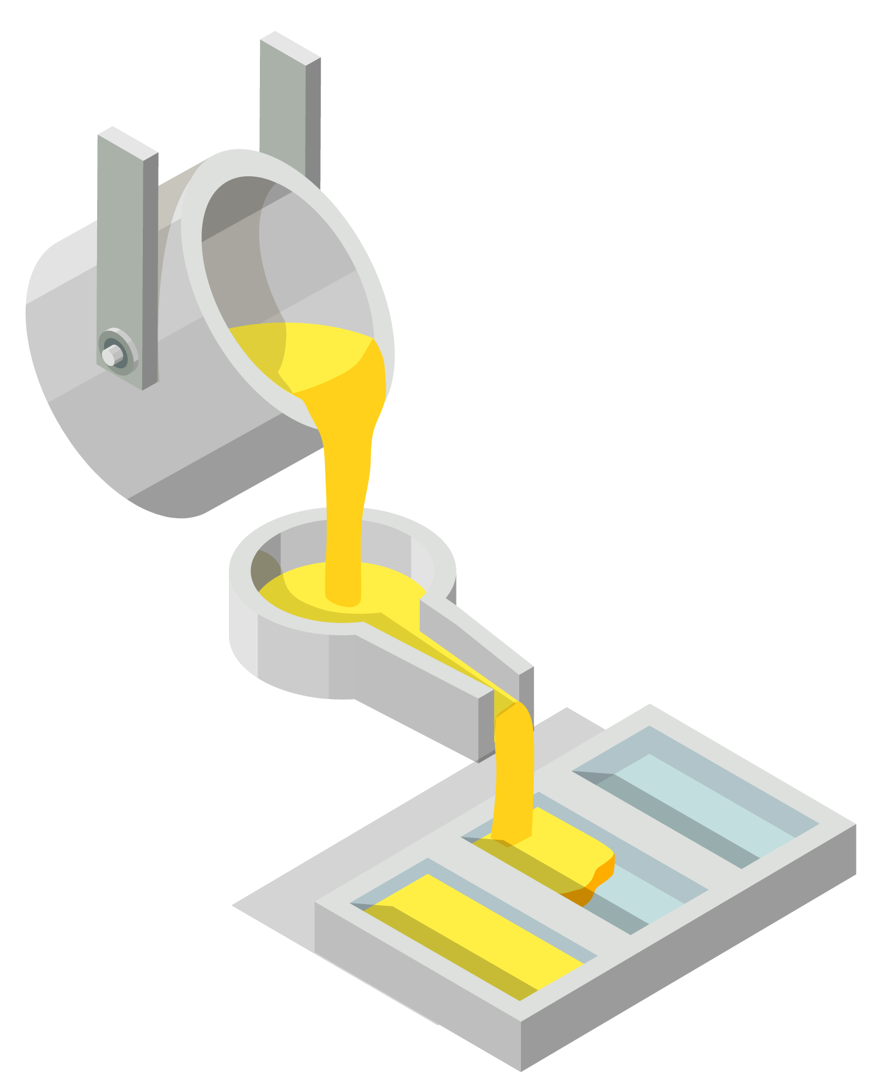
Table of contents
01
02
03
04
Introduction and Literature Survey
Flow Chart and Technology stack
Work Flow and Network Connections
Circuit Design and Output
Used sensors and basic connectivity learning methods
The output of health monitoring and flood prediction parameters and GUI

Slide 3

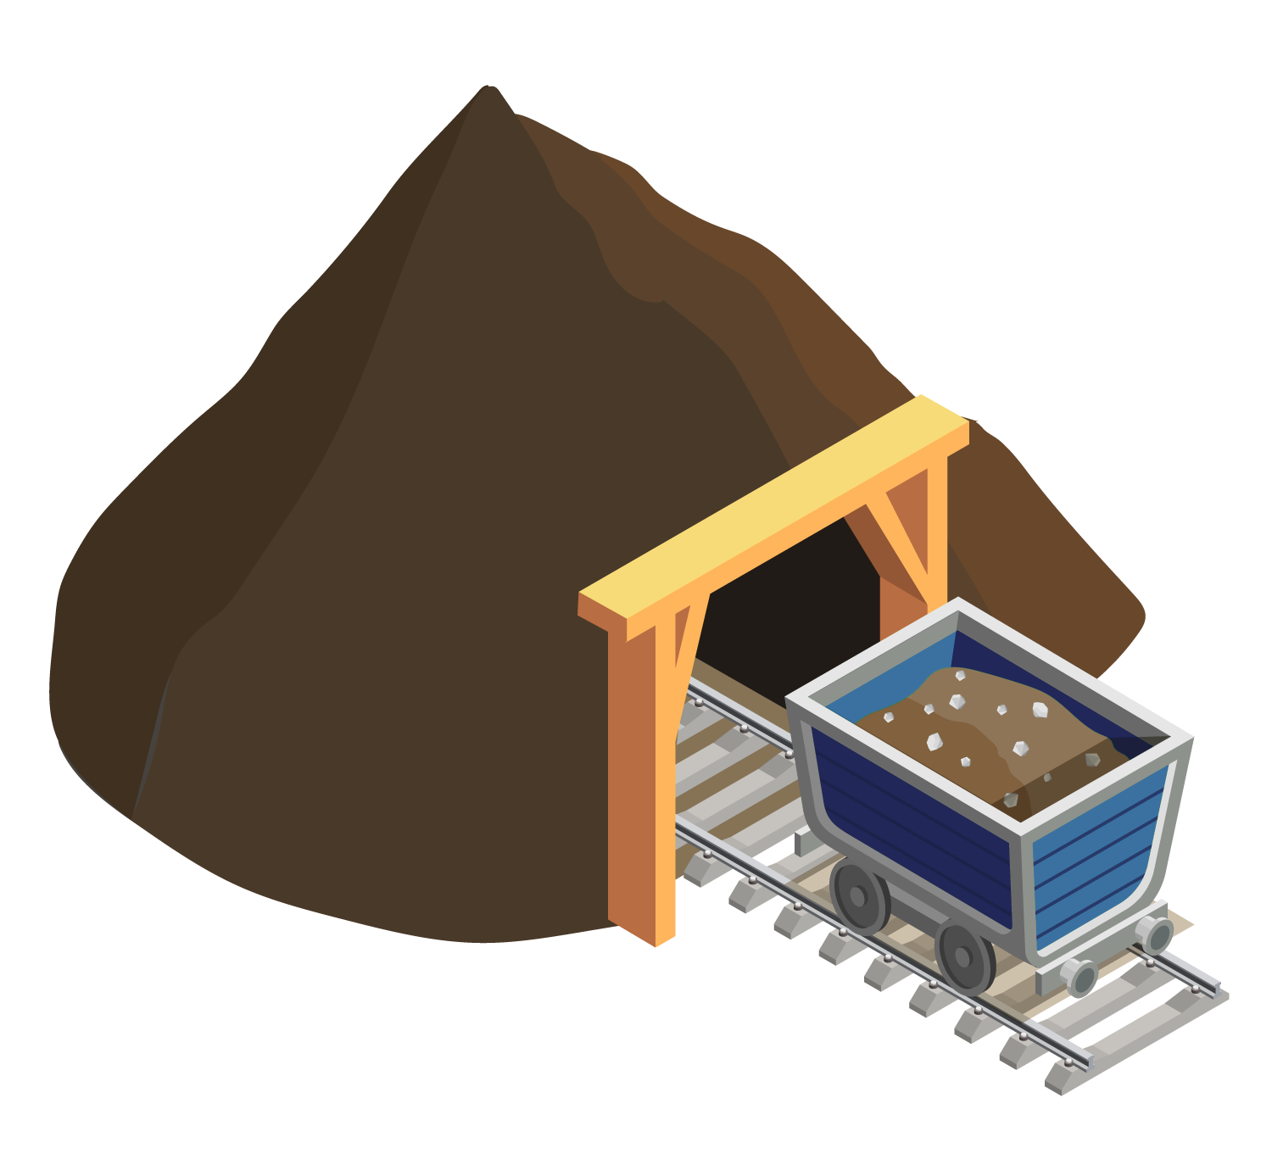

01
INTRODUCTION and LITERATURE SURVEY

Slide 4
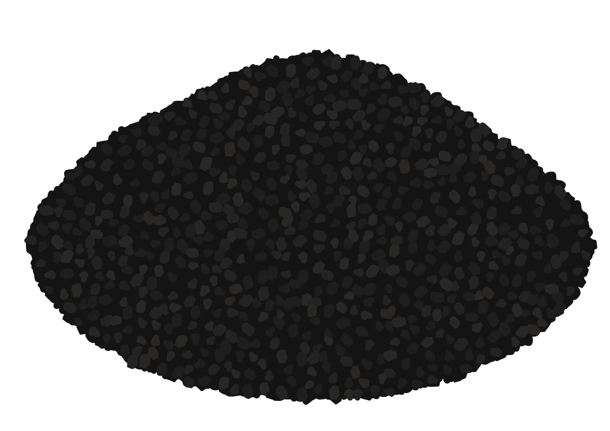
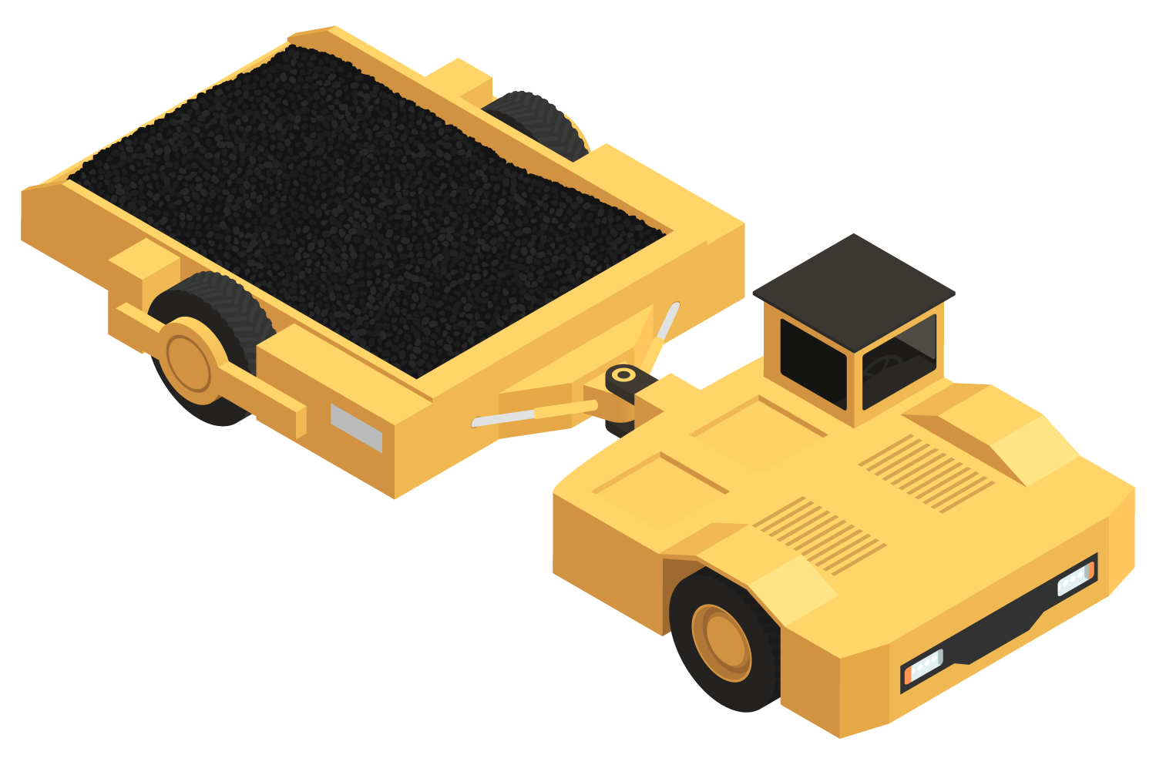
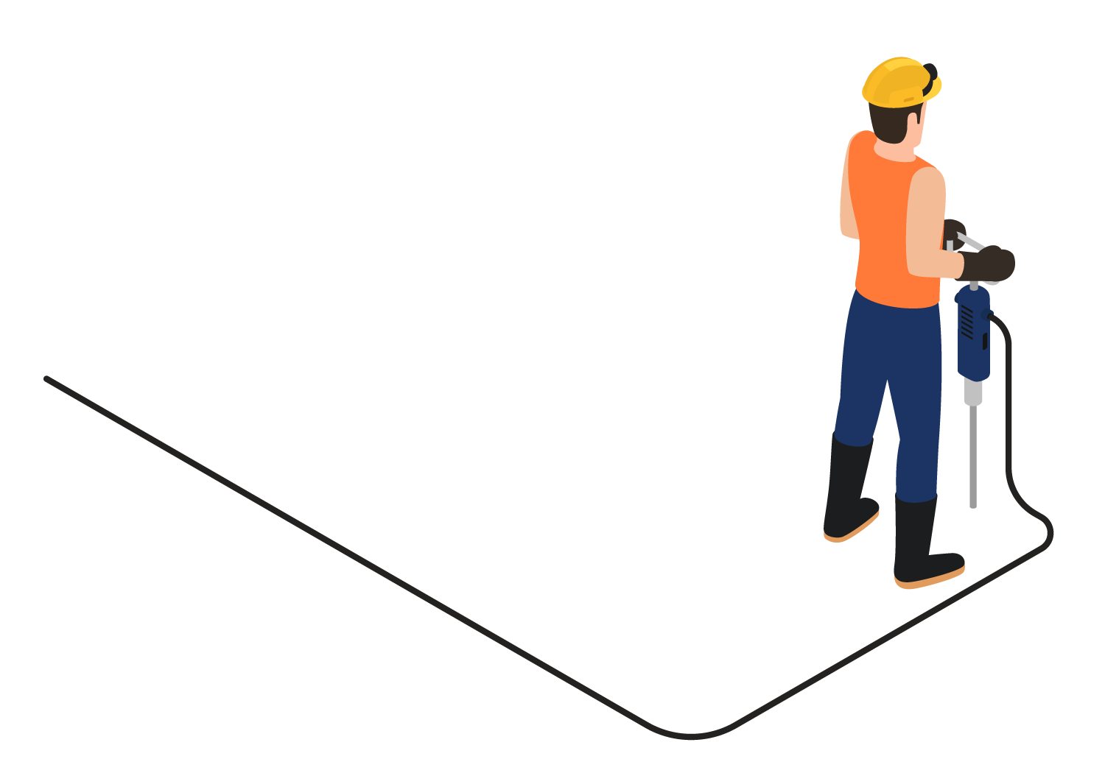
Introduction
The aim is to eliminate the safety problems due to mine flooding.
Providing workers’ health safety occurs due to the lack of a convenient working environment.
Sending alerts of flood by predicting to eliminate the life losses.

Slide 5
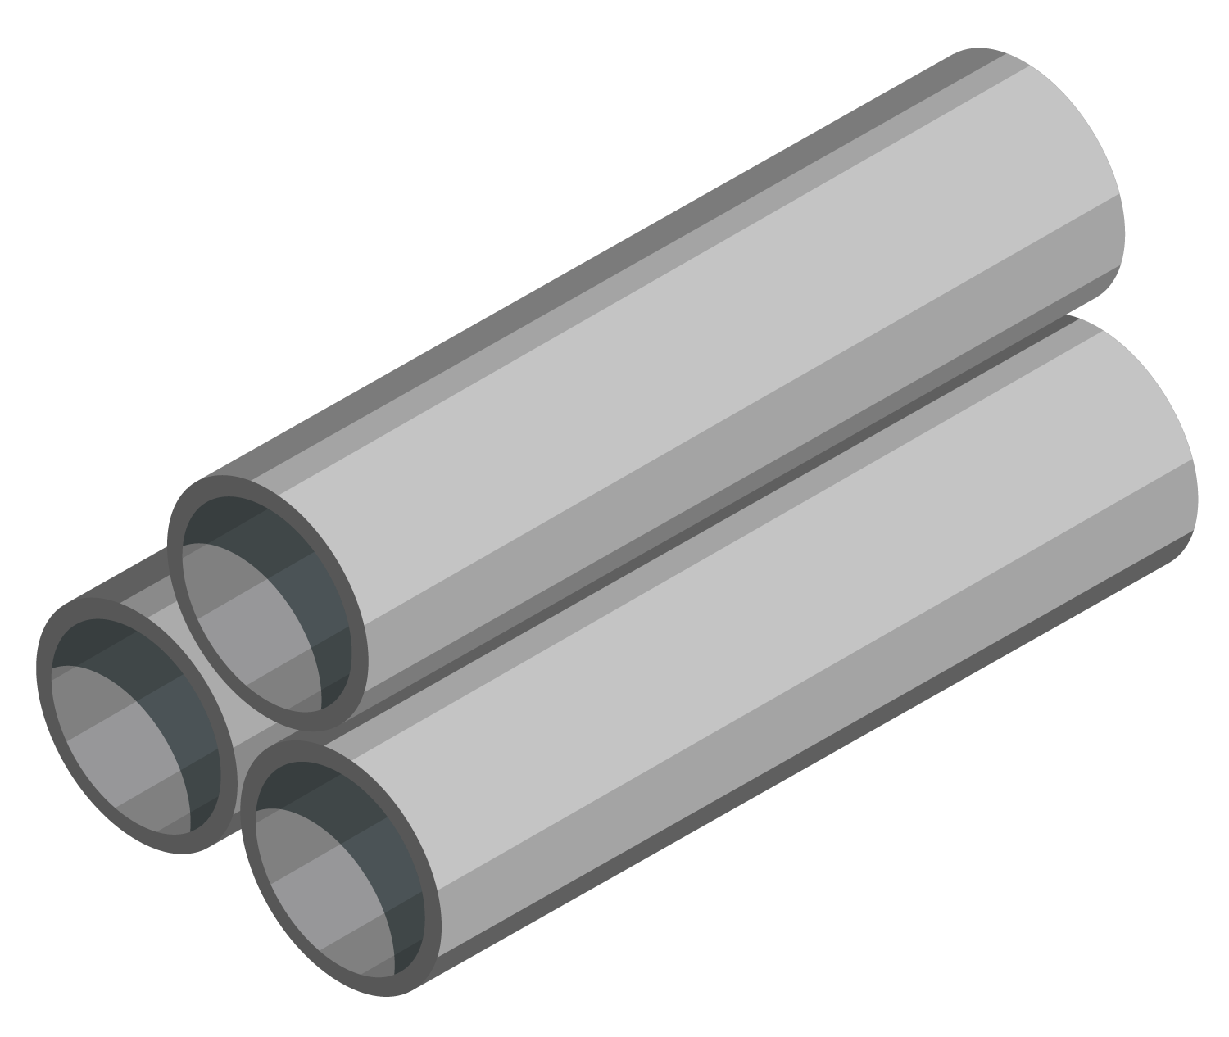
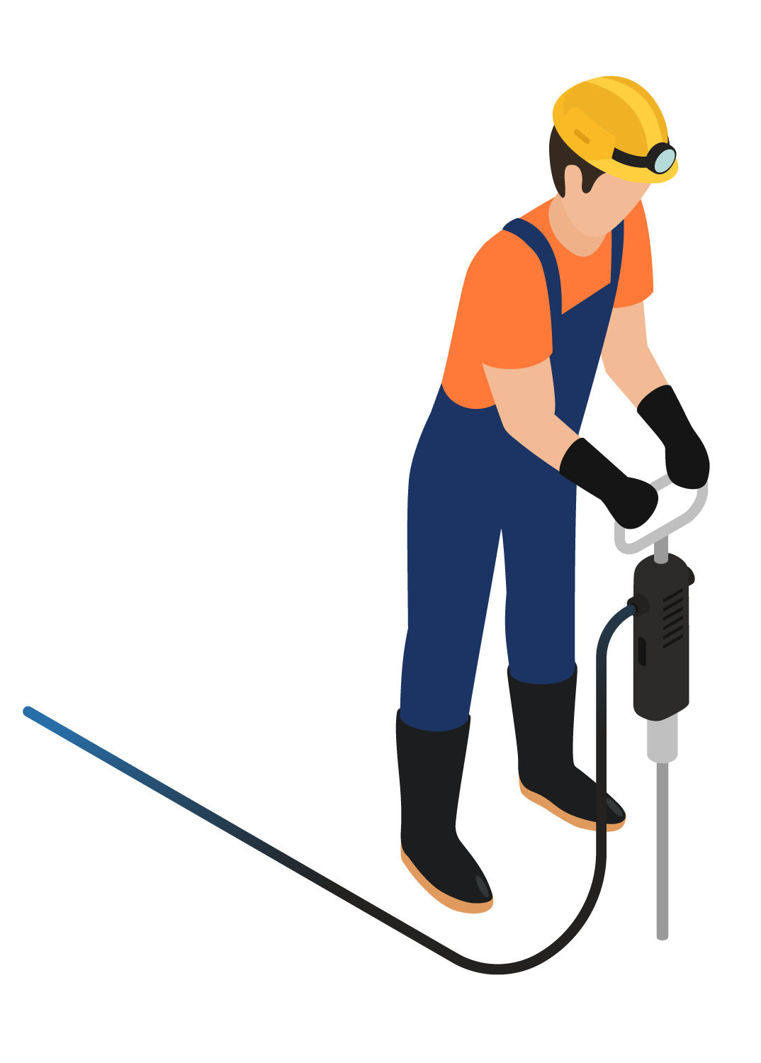
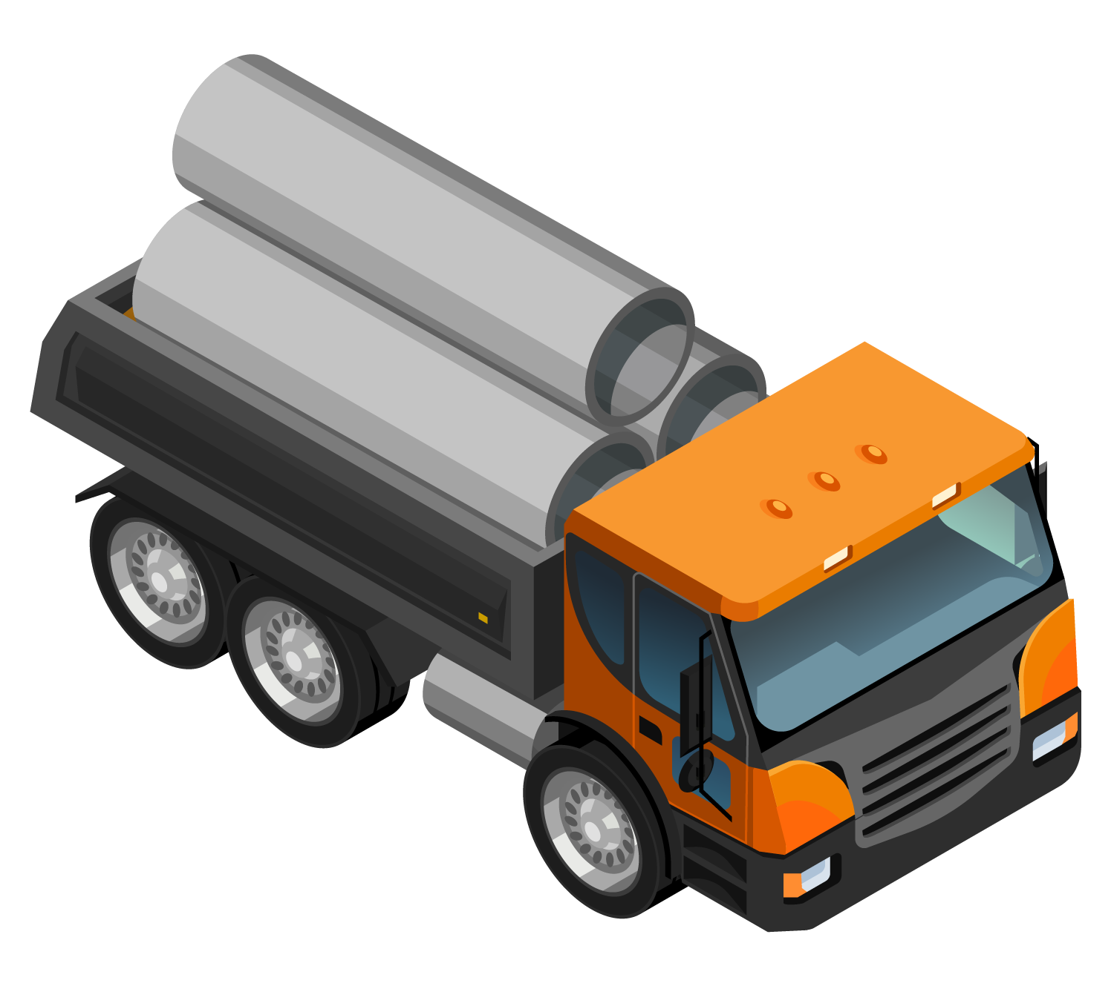
Literature survey
low-power wide area network (LPWAN)
Fog Computing, AWS, ThingsSpeak [4]
Zigbee-based wireless sensor network (WSN)[1]
LoRaWAN is a media access control(MAC)and multi-point protocol for wide-range networks.
nRF24L01(transceiver IC)
Microcontrollers- ESP, Arduino, Raspberry-pi

Slide 6
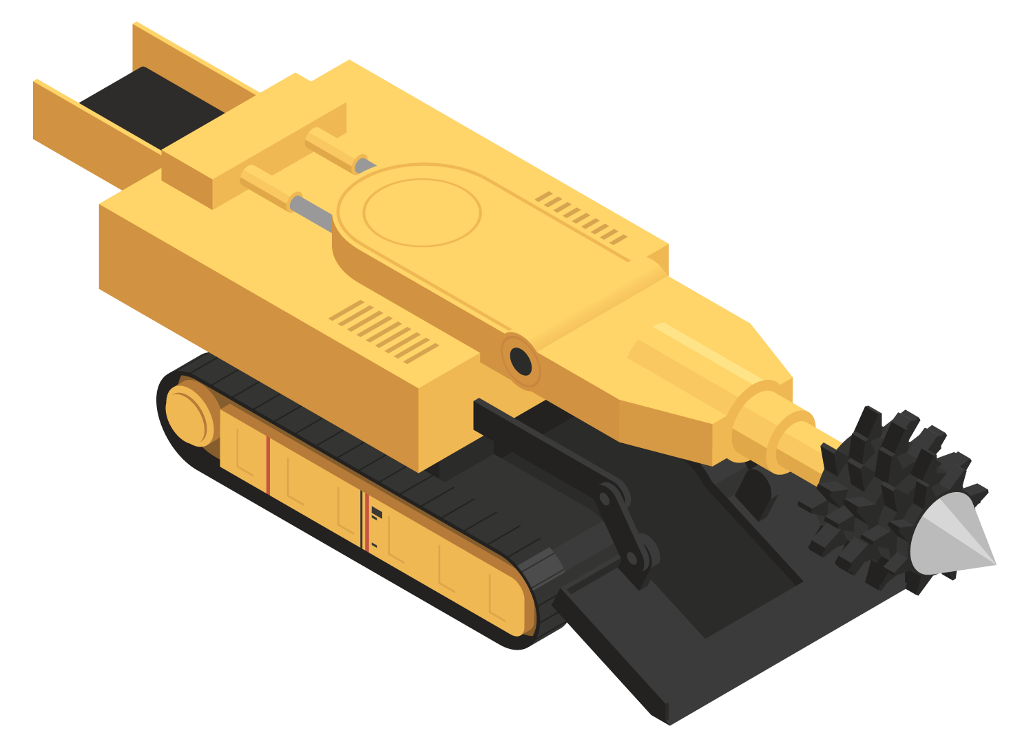
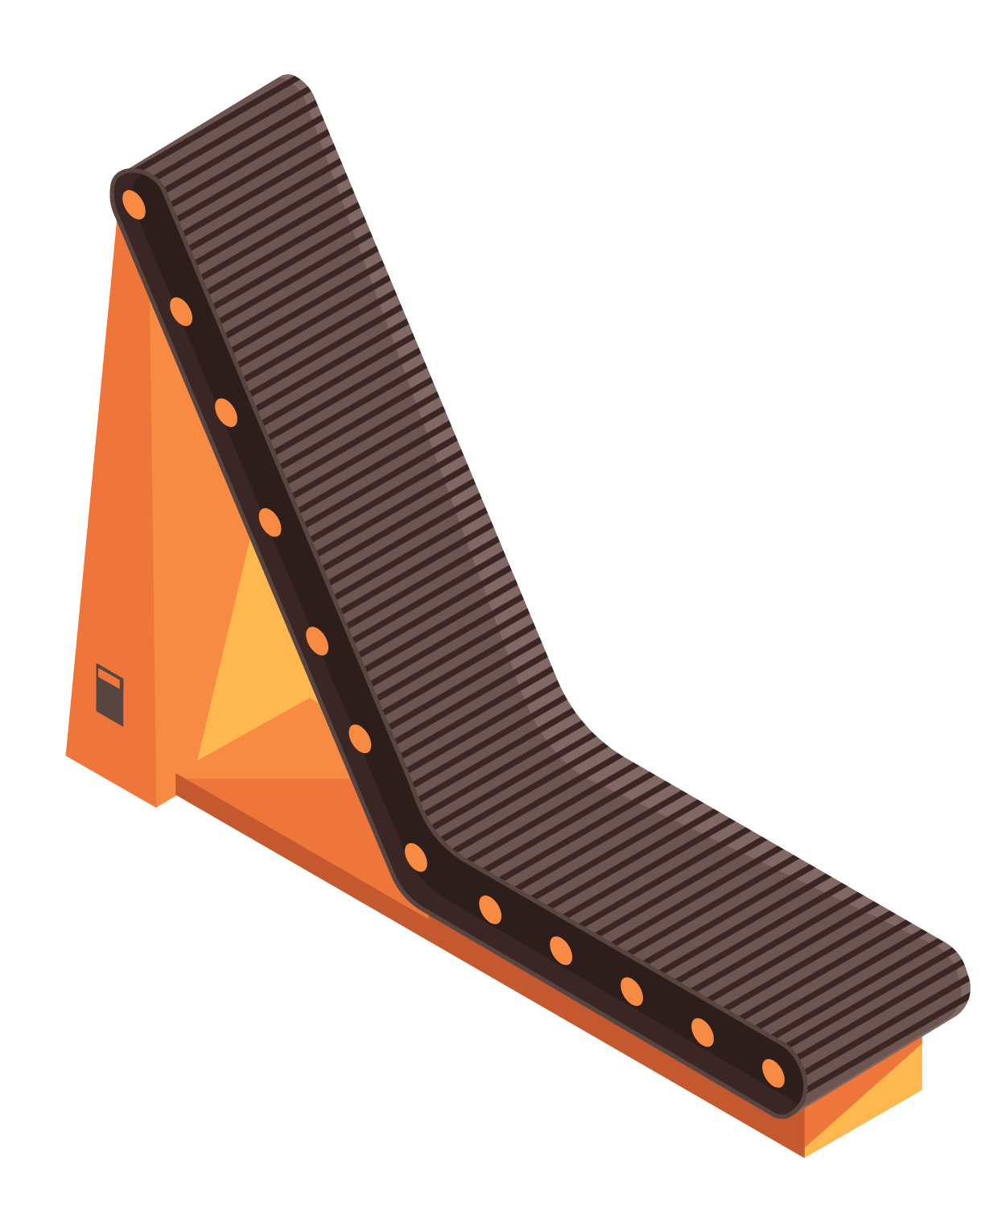

02
Flow Chart and Technology Stack

Slide 7
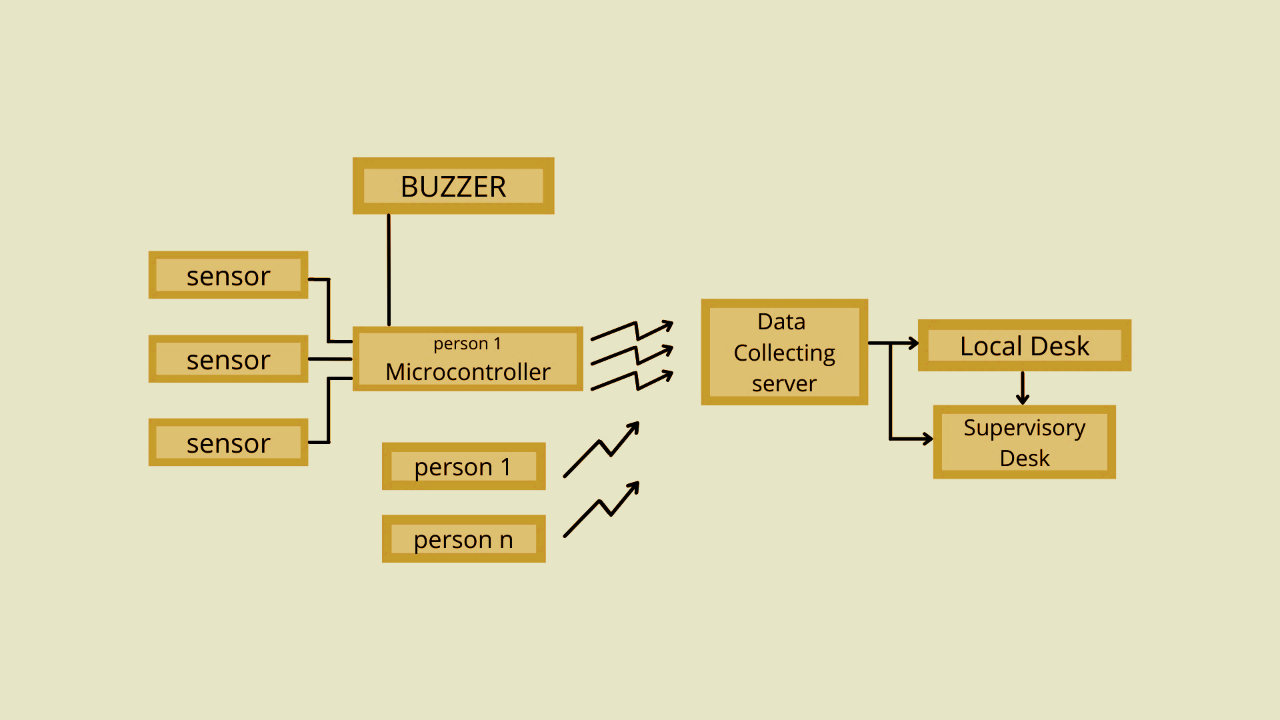
Flow Chart
1
2
3
2

Slide 8
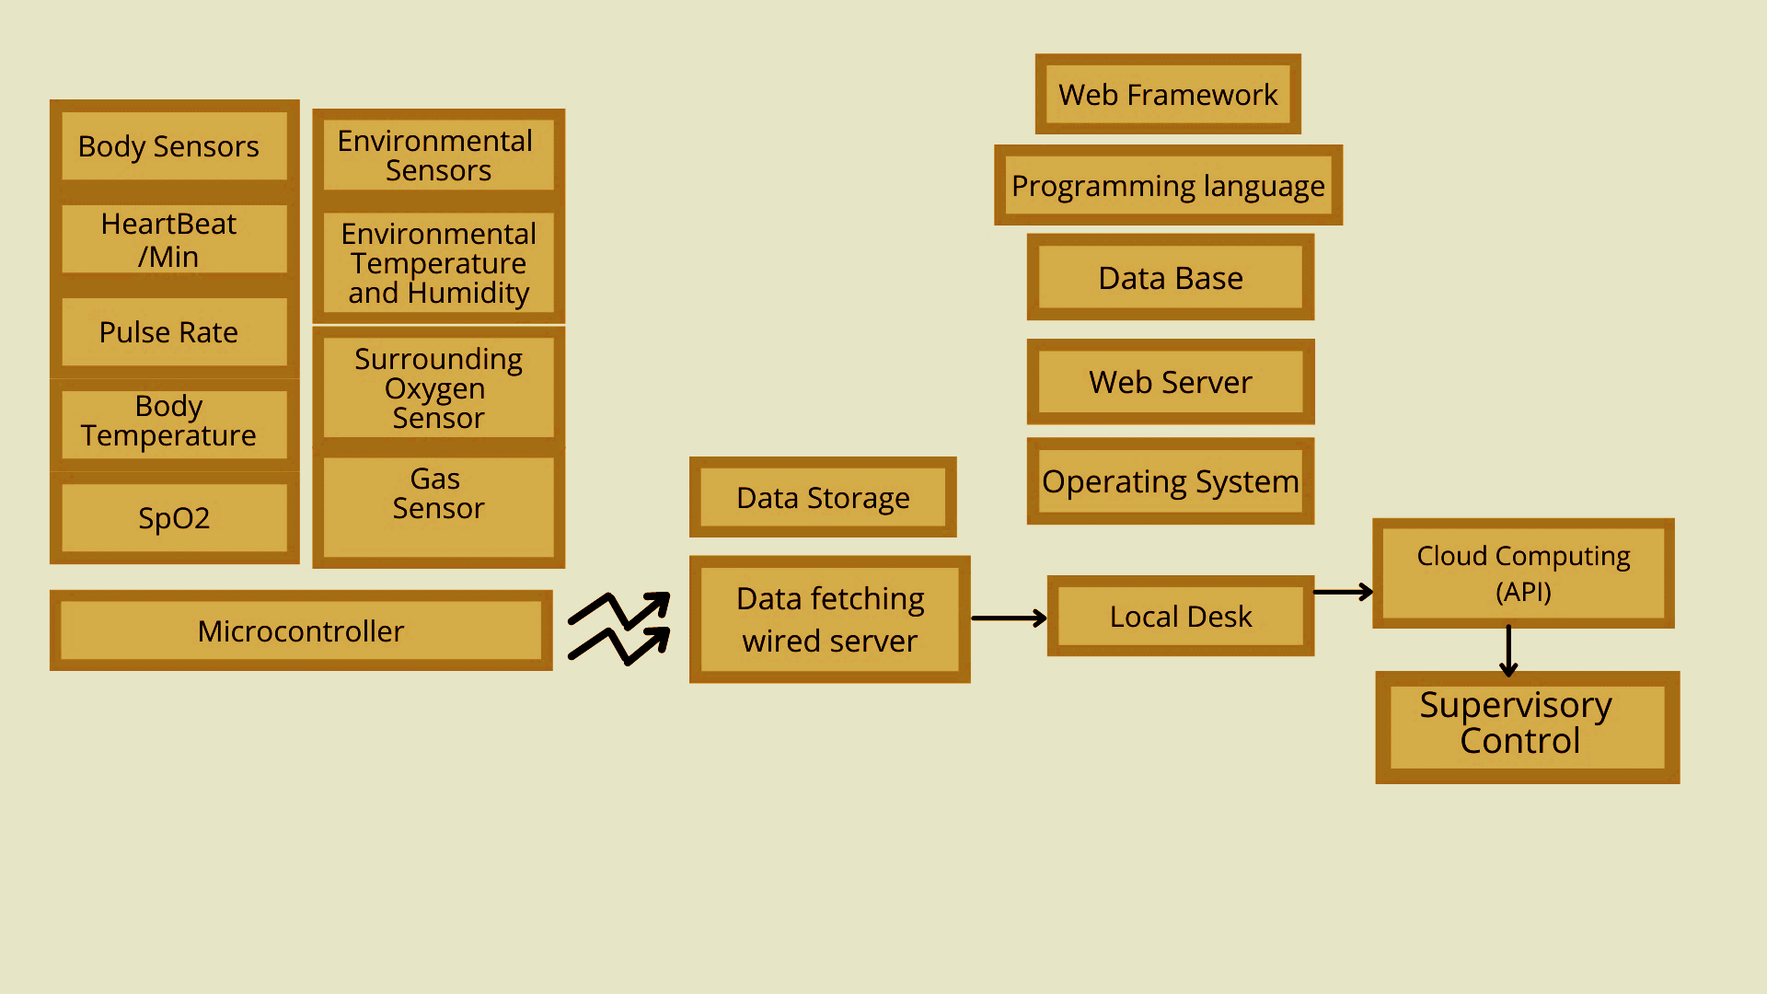
Technology stack

Slide 9



03
Work Flow and Network Connections

Slide 10
Work Flow
Collected by ESP-8266
Has all the control over data and the cloud
Manager’s Desk
Environment Parameter Data
Local Desk
HQ
Report/ Remark
Data Fetching HUB
Health Parameter Data
It will be manipulated by the local site manager
Collects and Gathers all received data and stores temporarily
collected by ESP-32

Slide 11
Network connections
Radio Frequency transmission
Data transmission cables
Cloud sharing and Internet connectivity
Microcontroller to Data fetching HUB
Data fetching HUB to Local Desk
Data fetching HUB and Local desk to Supervisory controller(Headquarter)

Slide 12
Used sensors and Code Language
Health Parameters:
Heart Rate and Spo2 sensor- MAX30100
Pulse Sensor
Body Temp Sensor DS18B20
Environmental Parameters
Temp and humidity sensor - DHT-11
Gas sensor - gas sensor MQ2
Soil moisture sensor
Python as Coding Language

Slide 13
04
Circuit Design and Outputs

Slide 14
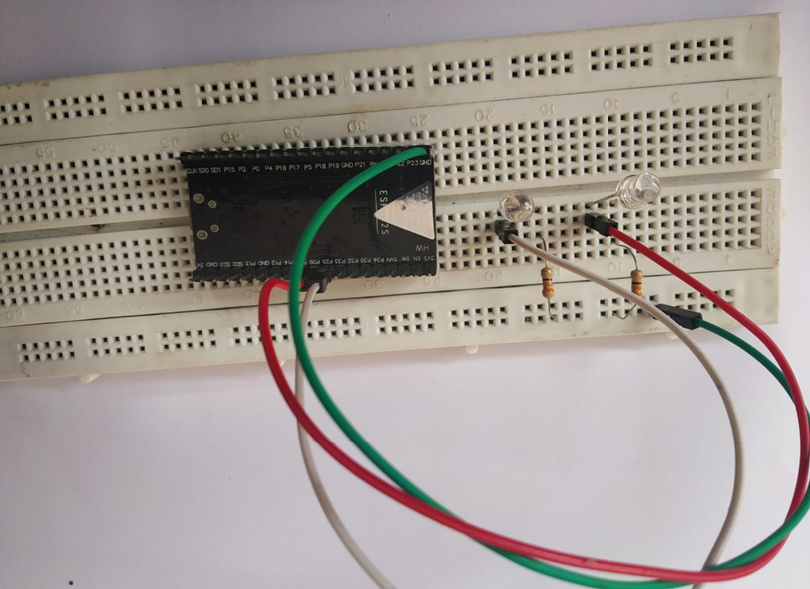
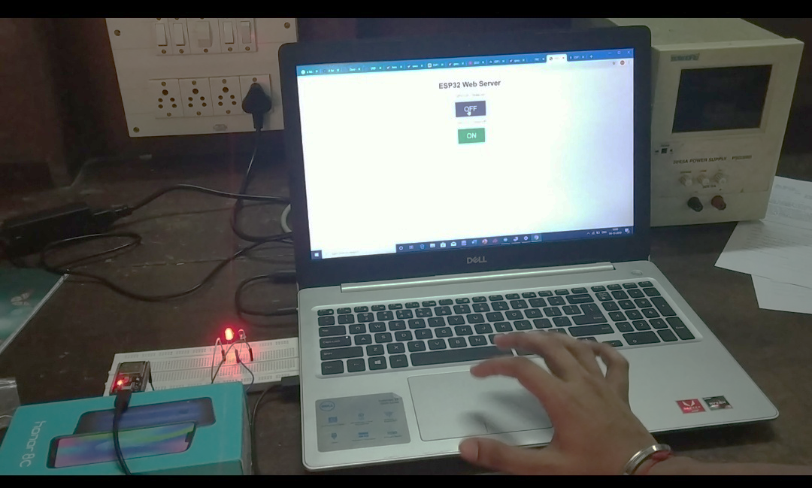
Basic LAN Wifi Connections using ESP

Slide 15
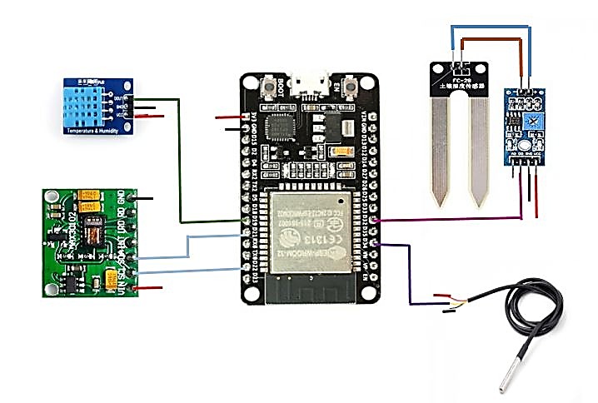
Circuit Diagram

Slide 16
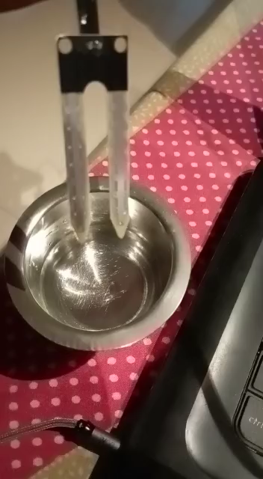
Output for flood prediction parameters

Slide 17


Slide 18
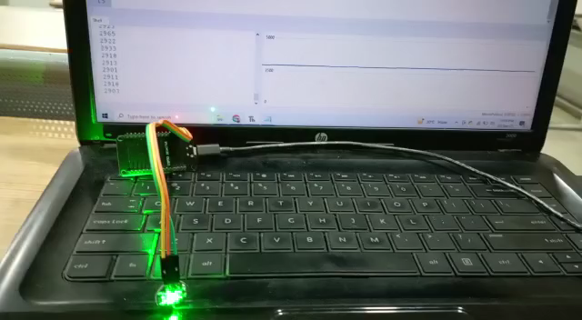
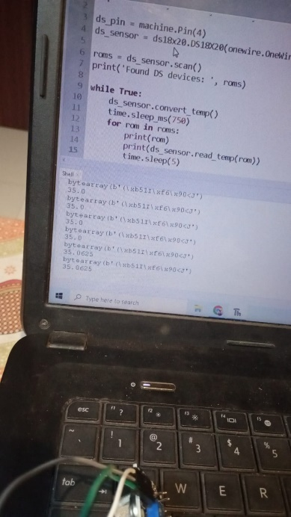
Body parameters output
Pulse sensor
Body temperature sensor

Slide 19

GUI OUTPUT

Slide 20

Output

Slide 21
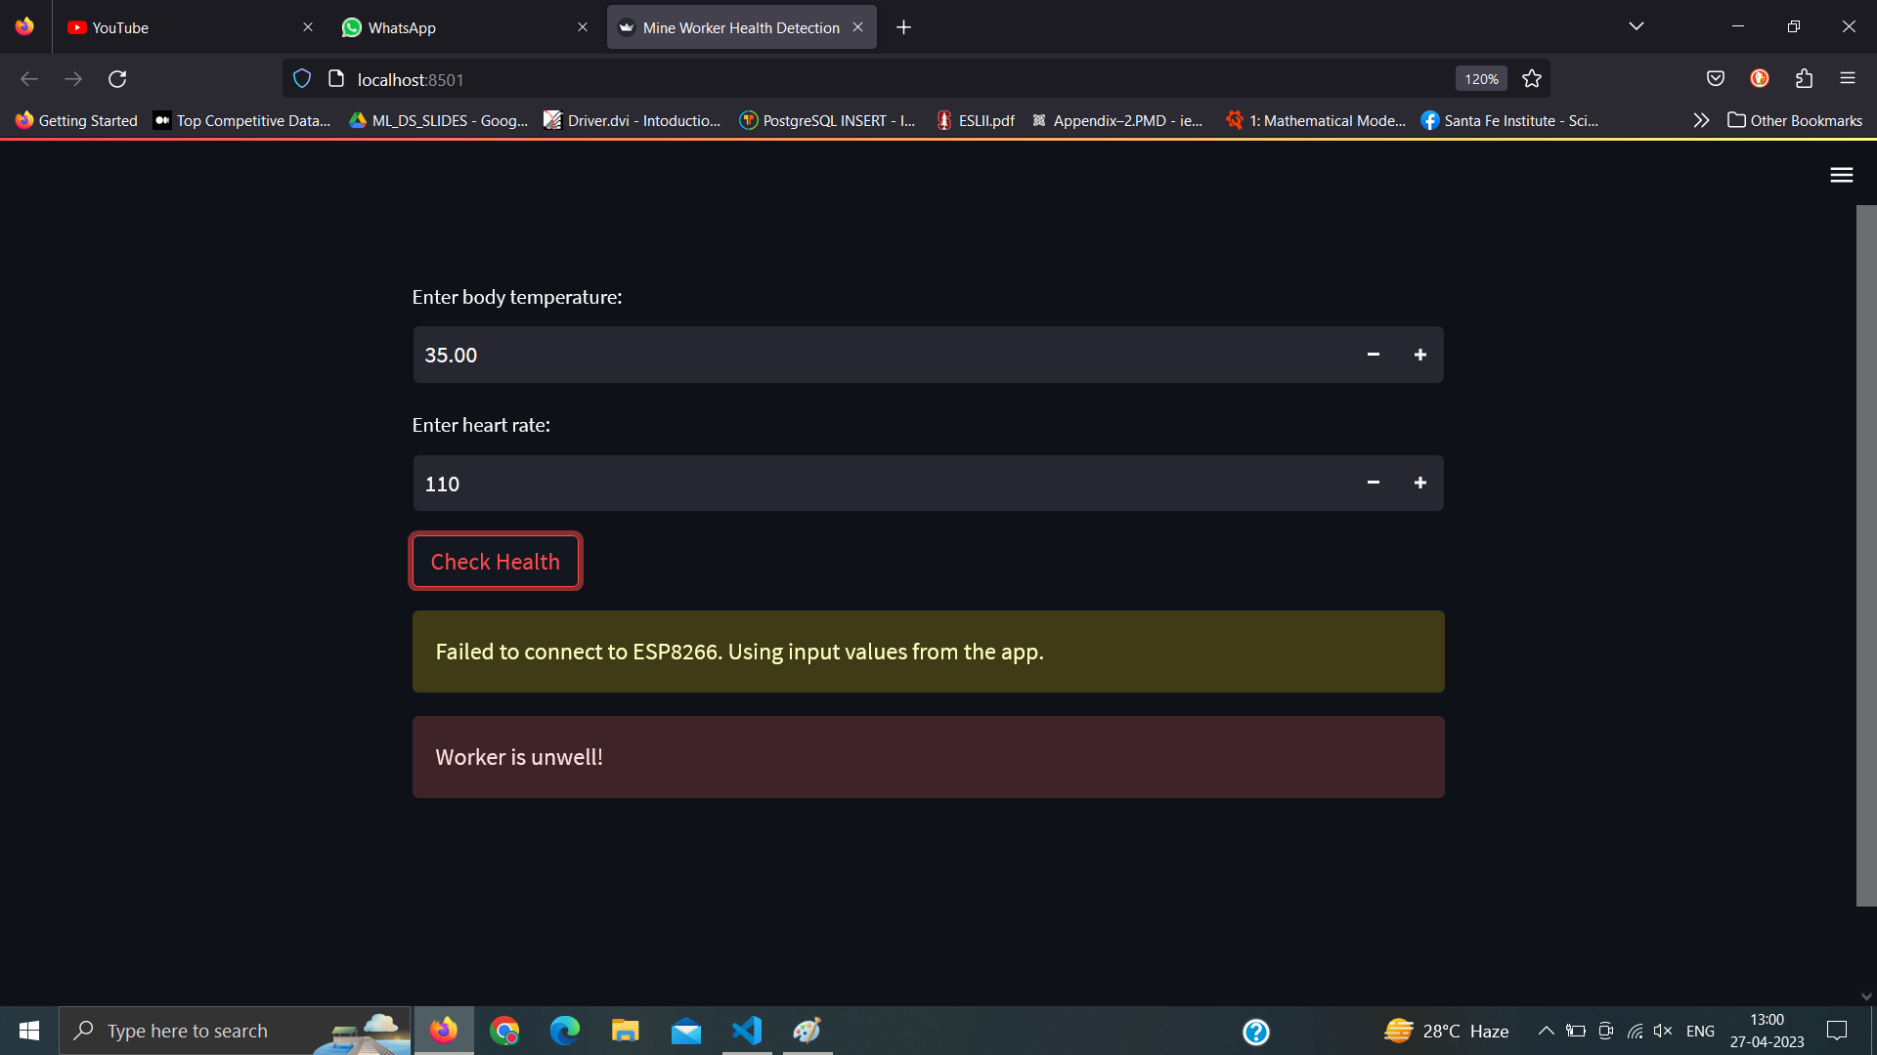
Output

Slide 22
Conclusion
Smoke sensors, Heartbeat sensors for health data,
Environmental conditions are used in the mine worker safety system.
Smart alert In the event of any deadly accidents
Mechanism is in place to ensure the safety of mine workers by warning them just in time to leave the area.
System uses wireless technology to monitor the mine environment parameters and worker parameters

Slide 23
Future Scope
Integration of advanced sensors for air quality and pollution monitoring
IoT-based solutions for real-time data collection and analysis
Advanced modeling and simulation techniques for accurate flood prediction
Machine learning algorithms for improved flood risk assessment

Slide 24
References
Geetha, A.. (2014). Intelligent helmet for coal miners with voice over ZigBee andenvironmental monitoring. World Applied Sciences Journal.20. 2328-2330. 10.5829/idosi.mejsr.2014.20.12.332
R. K. Kodali and A. Sahu, ”An IoT based soil moisture monitoring onLosant platform,” 2016 2nd International Conference on ContemporaryComputing and Informatics (IC3I), Greater Noida, India, 2016, pp. 764-768, doi: 10.1109/IC3I.2016.7918063
R. K. Kodali and K. S. Mahesh, ”Low cost ambient monitoring usingESP8266,” 2016 2nd International Conference on Contemporary Computing and Informatics (IC3I), Greater Noida, India, 2016, pp. 779-782,doi: 10.1109/IC3I.2016.7918788
V. Thirumala, T. Verma and S. Gupta, ”Injury analysis of mine workers: A case study,” 2017 IEEE International Conference on Industrial
https://www.beforetheflood.com/explore/the-crisis/climatechanging/
https://royalsocietypublishing.org/doi/10.1098/rsta.2019.0551#:~:text=As%2 0temperature%20increases%20so%20the,extreme%20precipitation%20may %20increase%20also

Slide 25
THANK YOU

